Slide 1
FY26 Copilot + Power Accelerate Partner Guide
Drive business transformation for your customers
Notes:
Copyright © 2025 Microsoft Corporation. All rights reserved. MICROSOFT MAKES NO WARRANTIES, EXPRESS, IMPLIED OR STATUTORY, AS TO THE INFORMATION IN THIS PRESENTATION.

Slide 2
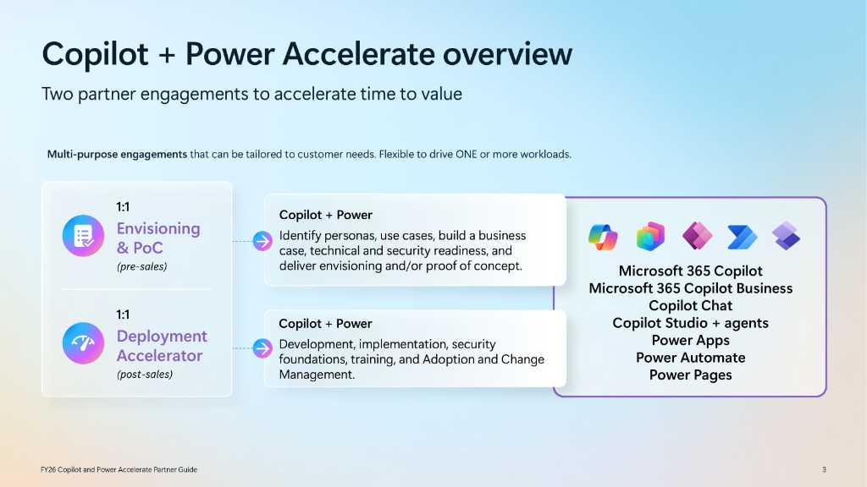
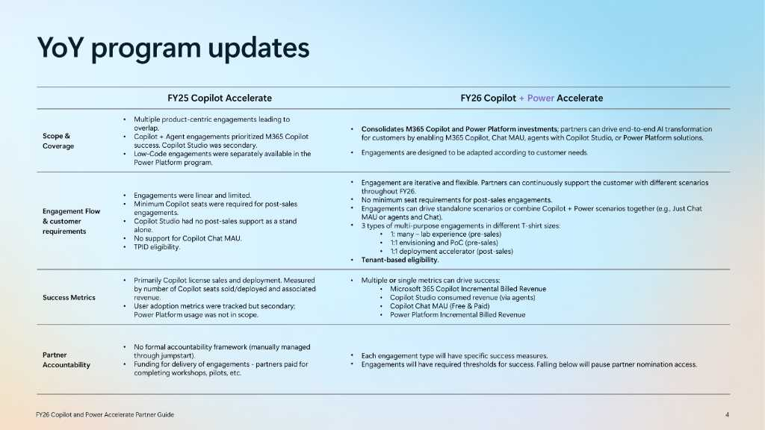

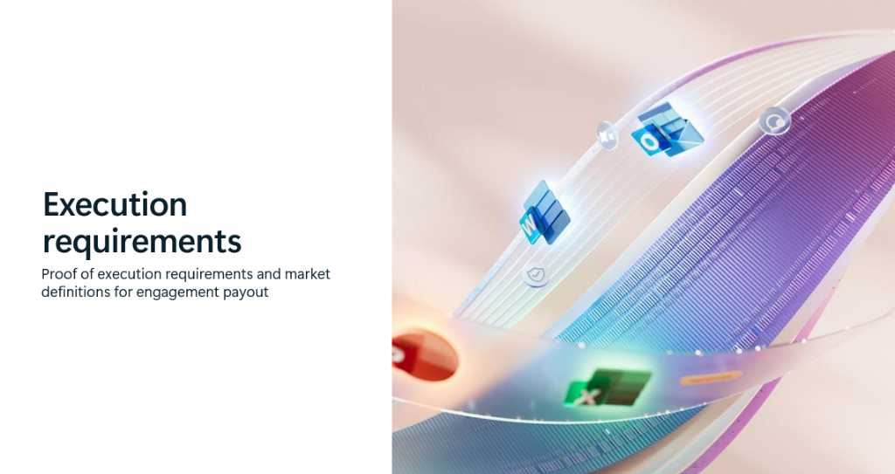
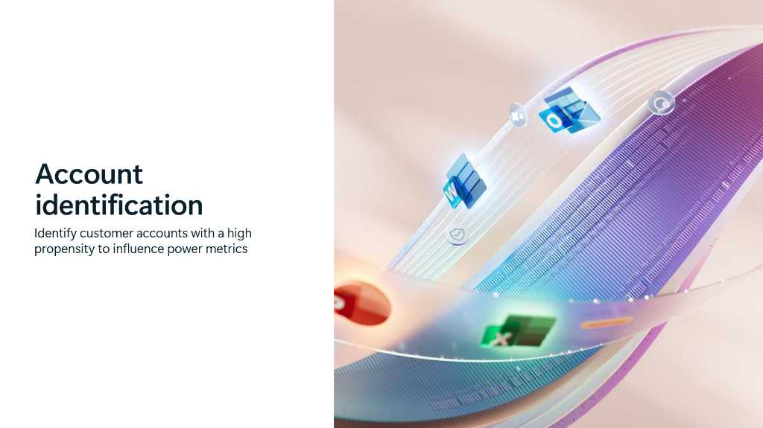












Contents
Overview
Program controls
Engagement portfolio
Proof of execution requirements
Scope and program changes
Account identification
Engagement model
FY26 partner qualifiers

Slide 3




Copilot + Power Accelerate overview
Two partner engagements to accelerate time to value
Multi-purpose engagements that can be tailored to customer needs. Flexible to drive ONE or more workloads.
1:1
Envisioning & PoC
(pre-sales)
Copilot + Power
Identify personas, use cases, build a business case, technical and security readiness, and deliver envisioning and/or proof of concept.
→
Microsoft 365 Copilot +
Copilot Business
Copilot Chat
Copilot Studio Agents +
Agent 365 (New!)
Power Platform
1:1
Deployment Accelerator
(post-sales)
Copilot + Power
Development, implementation, security foundations, training, and Adoption and Change Management.
→

Slide 4
YoY program updates
 | FY25 Copilot Accelerate | FY26 Copilot + Power Accelerate
Scope & Coverage | Multiple product-centric engagements leading to overlap. Copilot + Agent engagements prioritized M365 Copilot success. Copilot Studio was secondary. Low-Code engagements were separately available in the Power Platform program. | Consolidates M365 Copilot and Power Platform investments; partners can drive end-to-end AI transformation for customers by enabling M365 Copilot, M365 Copilot Business, Copilot Chat MAU, agents with Copilot Studio, Agent 365 or Power Platform solutions. Engagements are designed to be adapted according to customer needs.
Engagement Flow & customer requirements | Engagements were linear and limited. Minimum Copilot seats were required for post-sales engagements. Copilot Studio had no post-sales support as a stand alone. No support for Copilot Chat MAU. TPID eligibility. | Engagements are iterative and flexible. Partners can continuously support the customer with different scenarios throughout FY26. No minimum Copilot seat requirements for post-sales engagements. Engagements can drive standalone scenarios or combine Copilot + Power scenarios together (e.g., Just Chat MAU or agents and Chat). 3 types of multi-purpose engagements in different T-shirt sizes: 1: many Immersion Briefing – lab experience (pre-sales) 1:1 envisioning and PoC (pre-sales) 1:1 deployment accelerator (post-sales) Tenant-based eligibility.
Performance Measures | Primarily Copilot license sales and deployment. Measured by number of Copilot seats sold/deployed and associated revenue. User adoption metrics were tracked but secondary; Power Platform usage was not in scope. | Multiple or single metrics can drive success: Microsoft 365 Copilot & Copilot Business, Agent 365 Incremental Billed Revenue Copilot Studio consumed revenue (via agents) Copilot Chat MAU (Free & Paid) Power Platform Incremental Billed Revenue
Partner Accountability | No formal accountability framework (manually managed through jumpstart). Funding for delivery of engagements - partners paid for completing workshops, pilots, etc. | Each engagement type will have specific performance measures*. Engagements will have required thresholds for success. Falling below will pause partner nomination access.
*see MCI Guide for more information

Slide 5
Engagement portfolio
Engagement overview, opportunity sizes, and performance measures

Slide 6
Copilot + Power Accelerate
Initiative summary
Consolidates M365 Copilot and Power Platform (low-code) investments into a single program. Partners can drive end-to-end AI transformation for customers and enable M365 Copilot and Copilot Business, Copilot Chat MAU, agents with Copilot Studio, Agent 365 or Power Platform solutions.
Engagement Portfolio |  | Pre-Sales | Post-Sales
Size | Min Customer Size | Envisioning & PoC | Deployment Accelerator
XXS | <500 O and/or M suite seats
XS | 500+ O and/or M suite seats | $5K | $5K
S | 1K+ O and/or M suite seats
 |  | $10K | $10K
M | 1.5K+ O and/or M suite seats
 |  | $25K | $25K
L | 3K+ O and/or M suite seats |  | $50K
Engagement summary
Copilot + Power Envisioning & PoC: 1:1 pre-sales engagements for activities like: identify use cases, build a business case, technical & security readiness, and deliver envisioning and/or PoC.
Copilot + Power Deployment Accelerator: 1:1 post-sales engagements for activities like: Technical deployment, developing agent and/or Power Platform solutions, training users & ACM
Up to 4 engagements allowed per eligible tenant
Performance measures
Requires partners to achieve incremental revenue growth in Copilot (including Microsoft 365 Copilot, M365 Copilot Business, Agent 365 and Microsoft 365 E7), Copilot Studio or Power Platform, or growth in Copilot Chat usage for completed engagements.
Partner eligibility: Copilot Jumpstart Ready/Prioritized Tier
Payouts listed reflect Market A pricing
O/M suite includes E3/E5/A3/A5/G3/G5, Business Standard & Premium SKUs

Slide 7
Copilot + Power Accelerate Performance Measurement
Performance Measurement – New in FY26
Effective July 1, 2025 performance measurement applies to Copilot + Power Accelerate engagements. Partners will need to maintain a 33% portfolio performance rate, which means that 33% of the completed engagements would need to meet defined performance criteria - a minimum growth in revenue or usage, monitored in quarterly milestones over 12 months after the engagement is completed.
How it works:
Partners will be paused for claiming new engagements if their portfolio performance rate falls below the required 33%.
If a partner is paused, in-progress engagements can continue to be delivered as per the incentive rules.
Microsoft will continue to pay partners for any claimed engagement that is completed and meets the POE requirements as per the incentive rules. Payment for an engagement completed as per incentive rules, is not contingent on meeting performance measurement requirements.
Copilot + Power Performance Measure Definitions:
These are the performance measures that apply to Copilot + Power engagements. Partners will need to show customer growth on one measure or a combination of multiple measures.
Copilot revenue: Incremental billed revenue from Microsoft 365 Copilot, M365 Copilot Business, Microsoft 365 E7 (M365 Copilot component), and Agent 365 licenses.
Copilot Chat Monthly Active Usage: Incremental deduplicated free and paid monthly active users (MAU) of Copilot Chat in the last 28 days on “web scope,” Including usage from agents (Line of Business, 1P, or 3P), across multiple user states (free with consumption, non-paying with Entra).
Copilot Studio revenue: Incremental Copilot Studio revenue. Includes Copilot Studio Message Packs billed revenue and Copilot Studio PAYG consumed revenue, which will be recognized the month following consumption.
Power Platform revenue (excluding PowerBI revenue): Incremental billed revenue, includes Power Apps, Power Automate, Power Pages.

Slide 8
Engagement overview
Pre-sales
Engagement Name | Type | Min Customer Size | Payout | Field Approval? | Hours
Copilot + Power Envisioning & PoC (XS) | Partner-led | 500+ BP/O/M users | $5k | N | 20 hrs.
Copilot + Power Envisioning & PoC (S) | Partner-led | 1k+ BP/O/M users | $10k | N | 40 hrs.
Copilot + Power Envisioning & PoC (M) | Partner-led | 1.5k+ BP/O/M users | $25k | N | 100 hrs.
Post-purchase
Engagement Name | Type | Min Customer Size | Payout | Field Approval? | Hours
Copilot + Power Deployment Accelerator (XS) | Partner-led | 500+ BP/O/M suite users | $5k | N | 20 hrs.
Copilot + Power Deployment Accelerator (S) | Partner-led | 1k+ BP/O/M suite users | $10k | N | 40 hrs.
Copilot + Power Deployment Accelerator (M) | Partner-led | 1.5k+ BP/O/M suite users | $25k | N | 100 hrs.
Copilot + Power Deployment Accelerator (L) | Partner-led | 3k+ BP/O/M suite users | $50k | N | 200 hrs.
O/M suite includes E3/E5/A3/A5/G3/G5, Business Standard & Premium SKUs

Slide 9
Partner performance measures
Pre-sales | Performance Measures
Engagement Name | Copilot $ | Copilot Chat MAU | Copilot Studio $ | Power Platform $*
Copilot + Power Envisioning & PoC (XS) | $50k | 500 users | $5k | $25k
Copilot + Power Envisioning & PoC (S) | $100k | 1k users | $10k | $50k
Copilot + Power Envisioning & PoC (M) | $250k | 2.5k users | $25k | $125k
Post-purchase | Performance Measures
Engagement Name | Copilot $ | Copilot Chat MAU | Copilot Studio $ | Power Platform $*
Copilot + Power Deployment Accelerator (XS) | $50k | 500 users | $5k | $25k
Copilot + Power Deployment Accelerator (S) | $100k | 1k users | $10k | $50k
Copilot + Power Deployment Accelerator (M) | $250k | 2.5k users | $25k | $125k
Copilot + Power Deployment Accelerator (L) | $500k | 5k users | $50k | $250k
O/M suite includes E3/E5/A3/A5/G3/G5, Business Standard & Premium SKUs
*Excludes Power BI

Slide 10
Scope and program objectives
Program overview and evolution from FY25 to FY26

Slide 11
Partner-initiated engagement model
Partner-initiated model
Caters to a broad set of eligible customers (as defined in the table below) for scale.
Publicly available to eligible partners and delivered primarily through Regional SI partners.
Partner leads customer nomination and approval; Microsoft sellers encouraged to share opportunity with partners.
Customer Size | Copilot + Power Envisioning & PoC | Copilot + Power Deployment Accelerator
<500 O and/or M suite seats | N/A | N/A
500+ O and/or M suite seats | Partner-initiated | Partner-initiated
1K+ O and/or M suite seats | Partner-initiated | Partner-initiated
1.5K+ O and/or M suite seats | Partner-initiated | Partner-initiated
3K+ O and/or M suite seats | N/A | Partner-initiated
Refer to engagement overview and partner performance measures slides to see customer and opportunity size details.
O/M suite includes E3/E5/A3/A5/G3/G5, Business Standard & Premium SKUs

Slide 12
Partner Co-Sell Guidance
Partner-initiated engagement
Check customer eligibility. (Link)
Jumpstart partners that meet ready or above tier are eligible to deliver.
Share customer opportunity via MSX partner-sharing.* Please include accelerator engagement details and nominate customer here: http://aka.ms/mci.
Where customer eligibility may need to be adjusted manually, a request may be submitted for Area GTM Manager approval. (Link)
Track the engagements activities: http://aka.ms/gtm-insights

Slide 13
Engagement details
Customer engagement model and eligibility requirements

Slide 14
Copilot + Power Envisioning & PoC
Customer scenario: Customers looking to understand feasibility for Microsoft 365 Copilot, Microsoft 365 Copilot Business, Copilot Chat, agents with Copilot Studio and/or Power Platform solutions .
Engagement summary: The Copilot + Power Envisioning & PoC engagement is designed for partners to deliver pre-sales activities that will progress Microsoft 365 E7, Microsoft 365Copilot, Agent 365, Copilot Chat, Agent, and/or Power Platform opportunities. Examples include: conducting a needs analysis, assessing the customer’s environment, developing a strategic roadmap for AI transformation, designing a solution blueprint, building a business case, and delivering a Proof of Concept. This engagement can be used by partners to achieve multiple outcomes: (1) purchase of new Microsoft 365 Copilot and/or M365 Copilot Business seats, (2) purchase of new Agent 365 and Microsoft 365 E7 seats, (3) increased usage of Copilot Chat(free & paid), (4) agent consumption, and (5) purchase of new Power Platform licenses.
Engagement term: July 1, 2025 – June 30, 2026, or until program cap is reached.
Customer eligibility & activity pay-out
Program | Type | Eligibility criteria (&) |  | Market A incentive | Market B incentive | Market C incentive | Partner Performance Measures
 |  | O365 E3/A3/G3+ users | Min. Hours
Copilot + Power Envisioning & PoC (XS) | Partner-led | ≥500 purchased O365 and/or M365* | 20 hrs. | $5,000 | $3,750 | $2,500 | Revenue: Microsoft 365 Copilot, Microsoft 365 Copilot Business, Agent 365, Microsoft 365 E7,Copilot Studio, Power Platform Usage: Copilot Chat Monthly Active Usage
Copilot + Power Envisioning & PoC (S) | Partner-led | ≥1k purchased O365 and/or M365* | 40 hrs. | $10,000 | $7,500 | $5,000
Copilot + Power Envisioning & PoC (M) | Partner-led | ≥1.5k purchased O365 and/or M365* | 100 hrs. | $25,000 | $18,750 | $12,500
The following limits are in effect:
The maximum approved claims per customer tenant are capped at four (4).​
The maximum concurrent claims per customer tenant are capped at one (1).​
Partner performance measurement applies to this engagement effective July 1, 2025. Refer to the performance measurement slide for this engagement in the MCI Guide for more information.
*Includes E3/E5/A3/A5/G3/G5, Business Standard & Premium SKUs.
Partner eligibility:
Must have a Microsoft AI Cloud Partner Program Agreement.
Must be enrolled in the Microsoft Commerce Incentives program.
Must have completed Copilot Jumpstart at the Ready tier or higher AND achieved a Modern Work, BizApps, or Data Security specialization.

Slide 15
Copilot + Power Envisioning & PoC activities
The set of activities that eligible partners can choose to implement as part of an engagement with eligible customer
 | Inspire | Assess | Design | Proof of Concept (PoC)
01 - Project & Engagement Management | Review delivery guide & engagement assets. Pre-engagement kick-off. | Determine which assessments will be run. | Deliver executive summary. | Identify IT Admin and prepare access to the environment.
02 - Business Value Analysis, Measurement, & Reporting | Deliver analytics overview. | Define success. | Develop an initial business case. Build a value realization plan. | Measure Proof of Concept results.
03 - Scenario Discovery & Solution Design | Showcase the Microsoft Scenario Library. | Determine high-value scenarios, solutions, or initiatives. |  | Define the scope of the Proof of Concept.
04 - Agents, Solutions, & Initiatives Development | Deliver demos. |  | Define technical/functional requirements and design. | Build Proof of Concept agent or solution.
05 - Security, Compliance, & Governance | Deliver Security & Governance overview. | Run Data Risk Assessment. | Plan remediation. | Monitor risky Copilot usage.
06 - Administration & Operations |  | Deliver Readiness Assessments. | Prepare environment for Proof of Concept. | Enable trial license(s).
07 - Immersion, Training, & Adoption | Deliver product overviews, customer stories, and case studies. Deliver ACM best practices. |  | Build adoption roadmap. | Provide training to Proof-of-Concept users.

Slide 16
Partners can customize their engagement delivery approach according to their customer’s needs
DELIVERING PARTNER IMPACT | Copilot + Power Envisioning & POC
To impact these metrics…
Take your customer on an engagement journey
Choose a path according to your customer’s needs
Deliver a versatile set of activities to your customer (examples only)
Copilot + Power Envisioning & PoC
Deliver relevant Microsoft 365 Copilot & agents pitch decks
Show product demos
Facilitate scenario discovery & envisioning
Deliver business case
Copilot
Impacted metrics:
M365 Copilot & Copilot Business, Agent 365
and Microsoft 365 E7 Billed Revenue
01 M365 Copilot envisioning
02 Technical & Security readiness for AI
Deliver Secure & Govern Copilot pitch
Run Security for AI and Oversharing assessment with Purview
Review and discuss results for remediation and unblocking license purchase for M365 Copilot and M365 Copilot Business
+
Copilot Chat
Impacted metrics:
MAU
Align on agent and scenario buildout for proof of concept
Enable trial licensing, build and deploy PoC agent(s)
Deliver end user training & adoption i.e., prompt-a-thons, lunch & learns, etc.
Align on next steps and actions to scale deployment of Copilot + agents
+
03 Copilot + agents proof of concept
Copilot Studio
Impacted metrics:
Billed & Consumed Revenue
+
04 Power Platform envisioning
Define high-value scenarios, initiatives and success metrics
Build a value realization and adoption plan for Power Platform
Deliver executive summary with business case and next steps
Power Platform
Impacted metrics:
Billed Revenue
05 Power Platform proof of concept
Define technical/functional requirements and PoC design
Prepare environment and enable trial licenses
Build PoC agent or solution and provide training to end users

Slide 17
Copilot + Power Deployment Accelerator
Customer scenario: Customers not penetrated with Copilot paid licenses and/or Power Platform solutions; as well as customers with 20%+ Copilot paid license penetration looking to extend with agents or expand into new scenarios.
Engagement summary: The Copilot + Power Deployment Accelerator is designed for partners to deliver post-sales activities that progress deployment and adoption of Microsoft 365Copilot, Microsoft 365 Copilot Business, Copilot Chat, Agents, Agent 365, and/or Power Platform solutions. Examples include: technical deployment, implementing security and governance policies and controls, developing agent and/or Power Platform solutions, training users, and driving adoption and change management initiatives. This engagement can be used by partners to achieve multiple outcomes: (1) purchase of new Microsoft 365 Copilot and/or M365 Copilot Business seats, (2) purchase of new Agent 365 and Microsoft 365 E7 seats, (3)increased usage of Copilot Chat (free & paid), (4) agent consumption, and (5) purchase of new Power Platform licenses.
Engagement term: July 1, 2025 – June 30, 2026, or until program cap is reached.
Customer eligibility & activity pay-out
The following limits are in effect:
The maximum approved claims per customer tenant are capped at four (4).​
The maximum concurrent claims per customer tenant are capped at one (1).​
Partner performance measurement applies to this engagement effective July 1, 2025.Refer to performance measurement slide for this engagement in the MCI Guide for more information.
Program | Type | Eligibility criteria (&) |  | Market A incentive | Market B incentive | Market C incentive | Partner Performance Measures
 |  | O365 E3/A3/G3+ users | Min. Hours
Copilot + Power Deployment (XS) | Partner-led | ≥500 purchased O365 and/or M365* | 20 hrs. | $5,000 | $3,750 | $2,500 | Revenue: Microsoft 365 Copilot, Microsoft 365 Copilot Business, Agent 365, Microsoft 365 E7, Copilot Studio, Power Platform Usage:​ Copilot Chat Monthly Active Usage​
Copilot + Power Deployment (S) | Partner-led | ≥1k purchased O365 and/or M365* | 40 hrs. | $10,000 | $7,500 | $5,000
Copilot + Power Deployment (M) | Partner-led | ≥1.5k purchased O365 and/or M365* | 100 hrs. | $25,000 | $18,750 | $12,500
Copilot + Power Deployment (L) | Partner-led | ≥3k purchased O365 and/or M365* | 200 hrs. | $50,000 | $37,500 | $25,000
*Includes E3/E5/A3/A5/G3/G5, Business Standard & Premium SKUs.
Partner eligibility:
Must have a Microsoft AI Cloud Partner Program Agreement.
Must be enrolled in the Microsoft Commerce Incentives program.
Must have completed Copilot Jumpstart at the Ready tier or higher AND achieved a Modern Work, BizApps, or Data Security specialization.

Slide 18

Copilot + Power Deployment Accelerator activities
The set of activities that eligible partners can choose to implement as part of an engagement with their eligible customers
Activity categories | Get Ready | Onboard & Engage | Deliver Impact | Extend & Optimize
 | High-Level Activities
01 - Project & Engagement Management | Review the delivery guide and engagement assets. Pre-engagement kick-off. Conduct readiness review. | Review onboarding plans. | Implementation planning. Deliver IT and executive readouts. Complete post-engagement survey. | Post-engagement review with Microsoft.
02 - Business Value Analysis, Measurement, & Reporting | Develop an initial business case. Deliver analytics overview. | Configure and deploy analytics. | Measure business impact and usage/consumption. | Extend analytics. Evolve business case.
03 - Scenario Discovery & Solution Design | Identify priority business functions. Determine high-value scenarios, solutions, or initiatives. Develop a solution vision. | Define technical and functional requirements. Define design. | Conduct solution reviews. | Build backlog.
04 - Agents, Solutions & Initiatives Development | Confirm scenarios, design, and requirements. Refine backlog. Prepare environments. Define solution architecture. | Define non-technical initiatives. Build agents or solutions. | Deploy agents or solutions at scale. | Optimize agents or solutions.
05 - Security, Compliance & Governance | Address data security, governance, and data access. Complete assessments and plan remediation. Empower IT with security, compliance, and governance strategies. | Design secure and compliant governance. Ensure appropriate data security controls are in place. | Monitor reports. | Policy review and refinement.
06 - Administration & Operations | Environment readiness. Assign licenses or enable trials. Establish a service management plan. | Enable end users. Enable administrative tools. | Monitor and evaluate. Update service management plan. | Optimize operations. Continuous improvement.
07 - Immersion, Training & Adoption | Deliver product overviews and demos. Build adoption strategy. | Activate communities. Conduct end user training and communications. Deliver executive immersion experience. | Drive cross-organizational training and adoption. Gather user feedback and sentiment via surveys. Establish a Power Platform CoE. | Continuous training and adoption.

Slide 19
Partners can customize their engagement delivery approach according to their customer’s needs
DELIVERING PARTNER IMPACT | Copilot + Power Deployment Accelerator
To impact these metrics…
Take your customer on an engagement journey
Choose a path according to your customer’s needs
Deliver a versatile set of activities to your customer (examples only)
Copilot + Power Deployment Accelerator
01 Activate Copilot + Copilot Chat + agents
Enable Copilot Chat for users without Copilot licenses
Deliver a prompt-a-thon
Build, test, and deploy a basic agent
Copilot
Impacted metrics:
M365 Copilot & Copilot Business, Agent 365
and Microsoft 365 E7 Billed Revenue
+
02 Activate Copilot + Copilot Chat + agents
Enable 1000 users with M365 Copilot in various functions
Design, build, test and deploy an HR agent in customer’s environment
Copilot Chat
Impacted metrics:
MAU
Build and test a production ready Power Automate process automation flow
Design, build, test and demo a Power Pages site including up to 5 pages and 3 interactive forms and tables
+
03 Build Power Platform solutions
Copilot Studio
Impacted metrics:
Billed & Consumed Revenue
04 Activate Copilot Chat + agents
Enable 1000 users with Copilot Chat
Build, test, and deploy a basic agent for new users
Set up an agent governance plan
+
Power Platform
Impacted metrics:
Billed Revenue
Run Security for Copilot assessments, create a plan for remediations (clear security blockers)
Configure Microsoft Copilot Dashboard, deliver the overview of the Copilot Business Outcome, Adoption and Impact reports
05 Build your own path

Slide 20

Copilot + Power Accelerate | available trials
Partners can request specific trials for approved Copilot + Power Accelerate engagements via the Partner-Led Customer Trials Portal at: https://aka.ms/PLGTrialsRequest.
Available partner-led trials include Microsoft 365 Copilot, Copilot Studio, Agent 365, E3, and E5 Compliance
 | Available trial(s) | Terms
Copilot + Power Envisioning & PoC | Microsoft 365 Copilot SKU | Seats: 50 / Length: 60 days
 | Agent 365 license (recommended for customers with E5) | Seats: 50 /Length: 90 days (Agent 365 Only)
 | Copilot Studio Copilot Studio user license | Seats: 250 / Length: 60 days Seats: 250 / Length: 60 days
 | M365 E3 (no Teams) / M365 E3 EEA (no Teams) M365 E5 Compliance for Partner engagements | Seats: 250 / Length: 120 days (M365 E3 Only) Seats: 250 / Length: 120 days (E5 Comp Only)
Power platform*
Copilot + Power Deployment Accelerator | Agent 365 license (recommended for customers with E5) | Seats: 50 /Length: 90 days (Agent 365 Only)
 | Copilot Studio Copilot Studio user license | Seats: 250 / Length: 60 days Seats: 250 / Length: 60 days
 | M365 E3 (no Teams) / M365 E3 EEA (no Teams) M365 E5 Compliance for Partner engagements | Seats: 250 / Length: 120 days (M365 E3 Only) Seats: 250 / Length: 120 days (E5 Comp Only)
Power platform*
*Power Platform trials are public
*How to access Power Platform trials - Activate a trial or developer plan license to provide immersive experiences and kickstart customer activation - www.microsoft.com/power-platform/try-free
Nominate customers
Engage customers
Submit Trial Request
Customer engagement
Nominate your customer for the Copilot + Power Accelerate. The approved MCI engagement ID from the nomination will be needed in the trial request.
Review customer’s existing active licenses.
Define clear scope and success criteria.
Review the Trial Guide.
Request the customer trial https://aka.ms/PLGTrialsRequest
Activate trial(s)
Accelerate and realize opportunity

Slide 21
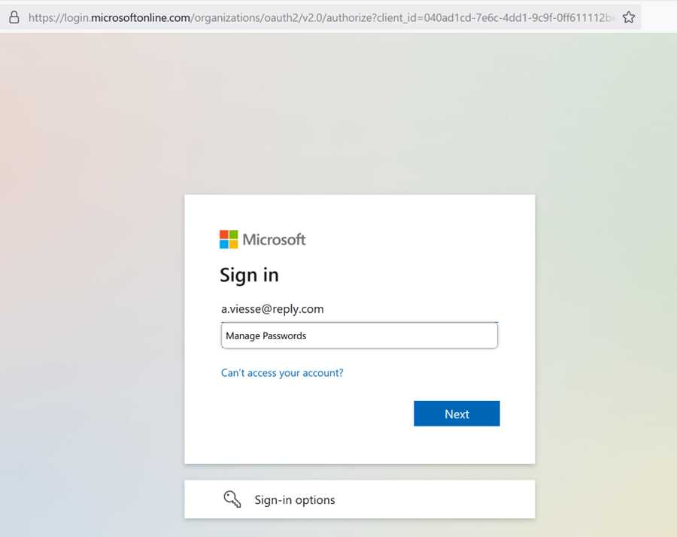
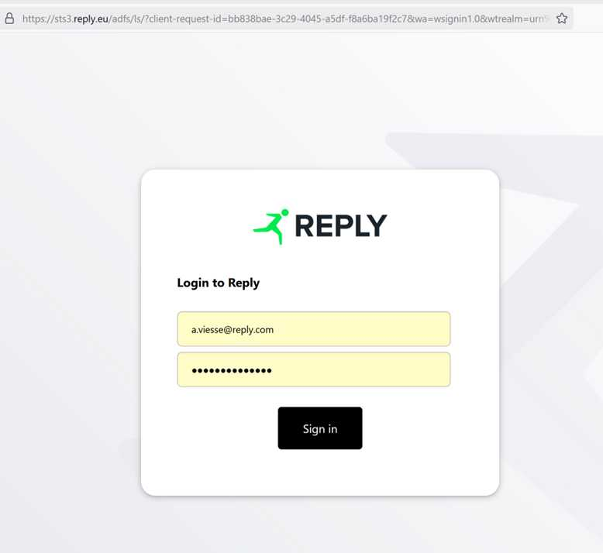
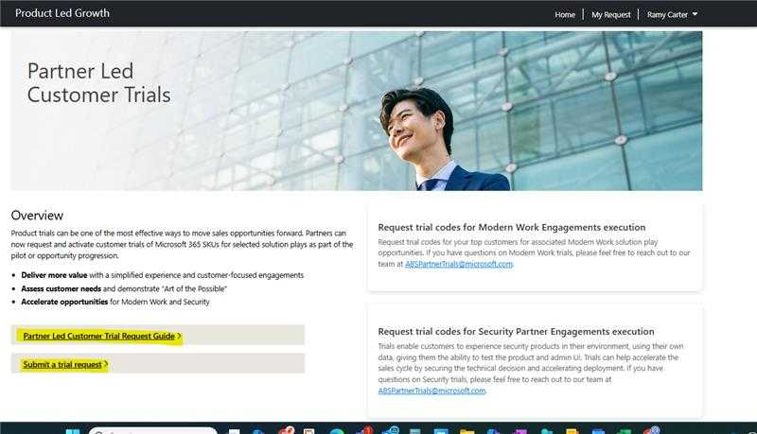
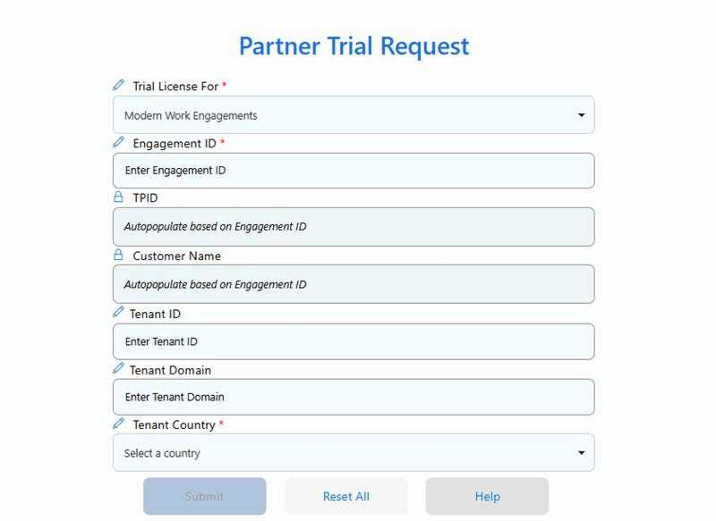
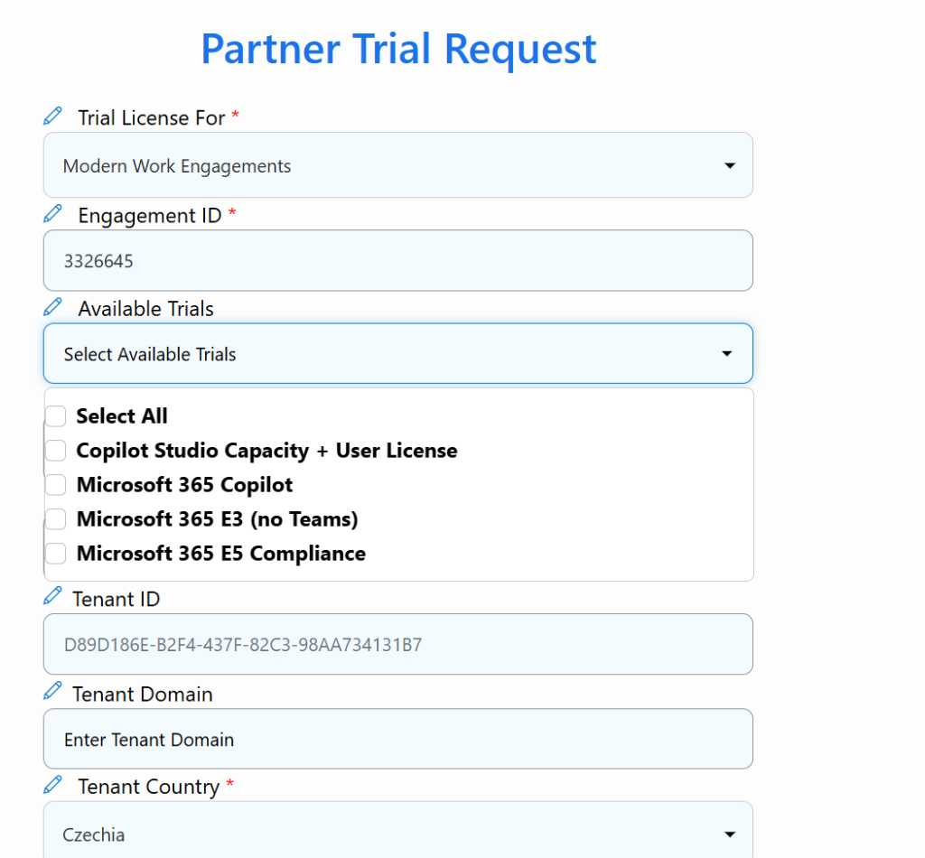
Details on how to request partner-led trials
Visit https://aka.ms/PLGTrialsRequest and sign in using your partner credentials.
Complete the sign-in process to access the portal.
Once signed in, you’ll be directed to the Partner-Led Customer Trials portal. This portal is only visible to authorized partners.
Submit engagement details, fill out required fields including your Engagement ID.
After your engagement is validated, you’ll be able to choose from the available trials based on what your engagement allows.
Review your selections, confirm the engagement, and the trials will be distributed accordingly.

Slide 22


How to access Power Platform trials
Activate a trial or developer plan license to provide immersive experiences and kickstart customer activation
Sign up for a free developer account—with no time limits
Get a 30-day free Power Pages trial
Power Apps
Power Pages
Get a 90-day free Power Automate trial
Get a 30-day free Copilot Studio trial
Power Automate
Copilot Studio
www.microsoft.com/power-platform/try-free
*Note – Copilot Studio is available in both the partner-led trial program for a 90-day trial offering and an openly available free 30-day trial. Select what meets the customer best.

Slide 23
What are the latest engagement controls and caps?
Repeatability controls
Engagement | Max approvals | POE completion timeline
Copilot + Power Envisioning & PoC (XS, S, M) | The maximum approved claims per customer tenant are capped at four (4) across all engagement sizes.​ The maximum concurrent claims per customer tenant are capped at one (1).​ | 90 days after the engagement completes
Copilot + Power Deployment Accelerator (XS, S, M, L) | The maximum approved claims per customer tenant are capped at four (4).​ The maximum concurrent claims per customer tenant are capped at one (1).​ | 90 days after the engagement completes

Slide 24
Partner Performance Measurement
Deep dive into performance accountability
*This only applies to Copilot + Power Envisioning & PoC and Copilot + Power Deployment Accelerator engagements

Slide 25
Partner Performance Measurement overview
Goals
Focus funding on partner activities that deliver measurable impact
Improve ROI by aligning budget with performance.
Standardize execution with new accountability rules.
When does this go into effect?
Scope: This applies to all Copilot + Power Accelerate engagements. The application will commence once a partner has completed 3 engagements for an engagement type.
Effective date: This control applies to all eligible Copilot + Power Accelerate engagements claimed from July 1, 2025, onward.

Slide 26
Partner Performance Measurement overview
Key principles
Performance measures
Tied to revenue or usage growth, based on engagement size and type.
Monitoring period
Engagements are tracked monthly for 12 months after proof-of-execution to assess goal achievement.
Quarterly milestones
Engagements must meet progressive performance measures each quarter (25%, 50%, 75%, 100%) to stay on track.
Portfolio performance rate
Partners must achieve a minimum 33% portfolio performance rate across all completed engagements.
PartnerOne application
Partners must meet portfolio performance rates at the PartnerOne level to start new funded engagements.

Slide 27
Goal attainment against performance measure
Engagement success definition: Achieving 100% of 1 goal; OR partial attainment of multiple goals that add up to 100%
1
There are four metrics that could be successful outcomes of a customer engagement.
2
Goals are established for each performance criteria that the partner must achieve by the end of the 12-month period.
Performance Criteria | Goal | Attainment | % Attainment
Copilot $ | $100k | $30k | 30%
Copilot Chat MAU | 1k users | 500 users | 50%
Copilot Studio $ | $10k | $2k | 20%
Power Platform $ | $50k | - | 0%
Total |  |  | 100%
Success
Engagement
Copilot + Power Accelerate Engagement Performance Example
3
A partner succeeds by either meeting 100% of one metric or combining partial progress across multiple metrics to reach 100% total attainment by the end of 12 months.
* Goals featured in the table are examples. Goals are established according to set engagement sizes.

Slide 28
Quarterly milestones
Completed engagements will be assessed against quarterly checkpoints to determine whether sufficient progress toward the success goal has been made:
Microsoft provides a Grace Period for the initial three months after submission of POE documentation.
During months 4-6, engagements will be expected to attain 25% of the annual performance goal.
During months 7-9, engagements will be expected to attain 50% of the annual performance goal.
During months 10-12, engagements will be expected to attain 75% of the annual performance goal.
At month 13, engagements will be expected to attain 100% of the annual performance goal.
Month | 1 | 2 | 3 | 4 | 5 | 6 | 7 | 8 | 9 | 10 | 11 | 12 | 13
Criteria | Grace Period |  |  | Milestone 1: 25% of Min Req |  |  | Milestone 2: 50% of Min Req |  |  | Milestone 3: 75% of Min Req |  |  | Milestone 4: 100% of Min Req

Slide 29
Onramp to Partner Performance Measurement
Customer approval received and engagement starts
POE submitted and partner paid
Drive customer impact ahead of Milestone 1
 | June | July | Aug | Sept | Oct | Nov | Dec | Jan | Feb | Mar | Apr | May | June
Engagement | Baseline | Eng starts |  | Eng completes | Grace Period |  |  | Milestone 1: 25% |  |  | Milestone 2: 50%
Growth calculated from engagement baseline
Monitoring period begins with monthly measurement against baseline month.
Partners can track progress against Milestone 1 while engagement matures toward first milestone.
Milestone 1: 25% of performance measure
Engagement reaches 3 months of maturity and is evaluated against Milestone 1 attainment.
Baseline = Customer revenue or usage from the month before customer approval received
Any growth against performance measures that occurs the month the engagement starts and later will count toward milestone attainment.
Reflects time period through June.
Milestones 3 and 4 continue July onward

Slide 30
Portfolio performance rates by engagement
Partners will be required to meet or exceed a minimum portfolio performance rate of 33% across all completed engagements for an engagement type within an incentive initiative:
Calculated separately for each engagement type (Envisioning and PoC vs Deployment Accelerator) and will only include engagements that are in Milestone 1 to Milestone 4 (no grace period engagements).
3+ completed engagements much reach Milestone 1 before the performance measurement is applied.
The portfolio performance rates are calculated and applied distinctly within an incentive initiative and do not influence a partner’s status on other incentive initiatives. The table below details how the engagements are grouped to calculate the portfolio performance rates.
Portfolio performance rate =
Total number of successful engagements /
Total number of completed engagements
For incentive initiatives that include both Envisioning & PoC and Deployment Accelerator engagement types:
If a partner fails to meet the 33% Portfolio performance rate on Envisioning & PoC engagements but does meet the portfolio performance rate for Deployment Accelerator engagements, the partners will be paused from claiming new Envisioning & PoC engagements only.
If a partner fails to meet the 33% Portfolio performance rate on Deployment Accelerator engagements but does meet the portfolio performance rate for Envisioning & PoC engagements, the partners will be paused from claiming new customers for both Envisioning & PoC and Deployment Accelerator engagements.
Incentive initiative | Portfolio Performance Rate
Copilot + Power Accelerate
Copilot + Power Envisioning & PoC (all sizes) | 33%
Copilot + Power Deployment Accelerator (all sizes) | 33%
30

Slide 31
Performance measures for multiple engagements
How is performance measurement applied to a customer who has had multiple Copilot + Power engagements with the same partner?
If a partner conducts multiple Copilot + Power engagements with the same customer tenant, the partner will be held accountable for an individual performance measure for each engagement and a cumulative performance measure, adding up the performance measures for all delivered engagements.
This will be measured in two ways:
Ensuring each engagement sees individual performance measure growth, as per the engagement T-shirt size, from the point the individual engagement started.
Ensuring the customer sees cumulative performance measure growth representative of all delivered engagements, as per the delivered T-shirt sizes, from the point the first engagement started.
Each engagement’s cumulative performance measure growth will be determined by the sequence of repeat engagements over time. Overlapping engagements may increase the cumulative measure for an individual engagement (i.e. a Copilot + Power Envisioning & PoC engagement occurring at the same time as a Copilot + Power Deployment Accelerator would increase the cumulative measures for both engagements.)
Cumulative Measures Example
Engagement | Cumulative Measure
Engagement 1 | E1
Engagement 2 | E1 + E2
Engagement 3 | E1 + E2 + E3
FY26 Copilot and Power Accelerate Partner Guide
31

Slide 32
Performance measures for multiple engagements
Scenario:
A customer receives a Copilot + Power Envisioning & PoC engagement with a September completion (E1), and a Copilot + Power Deployment Accelerator with a December completion (E2).
 | Engagement | June | July | Aug | Sept | Oct | Nov | Dec | Jan | Feb | Mar | Apr | May | June
1 | Copilot + Power Envisioning & PoC (S) | E1 baseline (June) | E1 starts |  | E1 completes | Grace Period |  |  | E1 M1: 25% |  |  | E1 M2: 50%
2 | Copilot + Power Deployment (M) |  |  |  | E2 baseline (Sept) | E2 starts |  | E2 completes | Grace Period |  |  | E2 M1: 25%
1 | Copilot + Power Envisioning & PoC (S) |  |  |  |  |  |  |  | E1 M1: 25% |  |  | E1 M2: 50%
2 | Copilot + Power Deployment (M) |  |  |  |  |  |  |  | Grace Period |  |  | E1 M2: 50% + E2 M1: 25%
Individual
Cumulative
Growth calculated from E1 baseline
Growth calculated from E2 baseline
Growth calculated for cumulative measures
from E1 baseline
An engagement will pass if the growth from the engagement’s baseline and the cumulative growth meets that month’s goal.

Slide 33
Example 1: Performance measures for multiple engagements
Example 1:
A customer receives a Copilot + Power Envisioning & PoC engagement with a September completion, and a Copilot + Power Deployment Accelerator with a December completion. Customer makes a purchase in September and customer usage increases in March.
 | Engagement | June | July | Aug | Sept | Oct | Nov | Dec | Jan | Feb | Mar | Apr | May | June
 | Customer Activity
1 | Copilot + Power Envisioning & PoC (S) | E1 baseline (June) | E1 starts |  | E1 completes | Grace Period |  |  | E1 M1: 25% |  |  | E1 M2: 50%
2 | Copilot + Power Deployment (M) |  |  |  | E2 baseline (Sept) | E2 starts |  | E2 completes | Grace Period |  |  | E2 M1: 25%
1 | Copilot + Power Envisioning & PoC (S) |  |  |  |  |  |  |  | E1 M1: 25% |  |  | E1 M2: 50%
2 | Copilot + Power Deployment (M) |  |  |  |  |  |  |  | Grace Period |  |  | E1 M2: 50% + E2 M1: 25%
Customer purchase
Customer usage increases
Individual
Cumulative
Growth calculated from E1 baseline
Growth calculated from E2 baseline
Growth calculated for cumulative measures
from E1 baseline
FY26 Copilot and Power Accelerate Partner Guide
33

Slide 34
Example 1: Performance measures for multiple engagements
Example 1: A customer receives a Copilot + Power Envisioning & PoC engagement with a September completion, and a Copilot + Power Deployment Accelerator with a December completion. Customer makes a purchase in September and customer usage increases in March.
Customer purchase in Sept
New usage reported in March
January | M365 CP $ | Chat MAU | CS $ | PP $ | Eng Status
Customer Growth | $200,000 | 0 | $0 | $0
Eng 1 Individual Goal June baseline | $25,000 | 250 users | $2,500 | $12,500 | Pass 800% attain
Eng 1 Attainment | 800% | 0% | 0% | 0%
Eng 1 Cumulative Goal June baseline | $25,000 | 250 users | $2,500 | $12,500 | Pass 800% attain
Eng 1 Attainment | 800% | 0% | 0% | 0%
Eng 2 Individual Goal September baseline | N/A | N/A | N/A | N/A | N/A Pre M1
Eng 2 Attainment
Eng 2 Cumulative Goal September baseline | N/A | N/A | N/A | N/A | N/A Pre M1
Eng 2 Attainment
April | M365 CP $ | Chat MAU | CS $ | PP $ | Eng Status
Customer Growth | $200,000* | 500 | $0 | $0
Eng 1 Individual Goal June baseline | $50,000 | 500 users | $5,000 | $25,000 | Pass 500% attain
Eng 1 Attainment | 400% | 100% | 0% | 0%
Eng 1 Cumulative Goal June baseline | $50,000 | 500 users | $5,000 | $25,000 | Pass 500% attain
Eng 1 Attainment | 400% | 100% | 0% | 0%
Eng 2 Individual Goal September baseline | $62,500 | 625 users | $6,250 | $31,250 | Fail 80% attain
Eng 2 Attainment | 0%* | 80% | 0% | 0%
Eng 2 Cumulative Goal September baseline | $112,500 | 1,125 users | $11,250 | $56,250 | Pass 221% attain
Eng 2 Attainment | 177% | 44% | 0% | 0%
*M365 Copilot revenue does not count against E2 because the customer purchase occurred in September, before the engagement started.
In January, E1 passes because it meets the cumulative and individual growth measures for that month.
In April, only E1 passes by meeting both the cumulative and individual growth measure. E2 fails because it does not meet both measures.

Slide 35
Example 2: Performance measures for multiple engagements
Example 2:
A customer receives a Copilot + Power Envisioning & PoC engagement with a September completion, and a Copilot + Power Deployment Accelerator with a December completion. Customer makes a purchase in December and customer usage increases in March.
 | Engagement | June | July | Aug | Sept | Oct | Nov | Dec | Jan | Feb | Mar | Apr | May | June
 | Customer Activity
1 | Copilot + Power Envisioning & PoC (S) | E1 baseline (June) | E1 starts |  | E1 completes | Grace Period |  |  | E1 M1: 25% |  |  | E1 M2: 50%
2 | Copilot + Power Deployment (M) |  |  |  | E2 baseline (Sept) | E2 starts |  | E2 completes | Grace Period |  |  | E2 M1: 25%
1 | Copilot + Power Envisioning & PoC (S) |  |  |  |  |  |  |  | E1 M1: 25% |  |  | E1 M2: 50%
2 | Copilot + Power Deployment (M) |  |  |  |  |  |  |  | Grace Period |  |  | E1 M2: 50% + E2 M1: 25%
Customer purchase
Customer usage increases
Individual
Cumulative
Growth calculated from E1 baseline
Growth calculated from E2 baseline
Growth calculated for cumulative measures
from E1 baseline
FY26 Copilot and Power Accelerate Partner Guide
35

Slide 36
Example 2: Performance measures for multiple engagements
Example 2: A customer receives a Copilot + Power Envisioning & PoC engagement with a September completion, and a Copilot + Power Deployment Accelerator with a December completion. Customer makes a purchase in December and customer usage increases in March.
Customer purchase in Dec
New usage reported in March
January | M365 CP $ | Chat MAU | CS $ | PP $ | Eng Status
Customer Growth | $50,000 | 0 | $0 | $0
Eng 1 Individual Goal June baseline | $25,000 | 250 users | $2,500 | $12,500 | Pass 800% attain
Eng 1 Attainment | 200% | 0% | 0% | 0%
Eng 1 Cumulative Goal June baseline | $25,000 | 250 users | $2,500 | $12,500 | Pass 800% attain
Eng 1 Attainment | 800% | 0% | 0% | 0%
Eng 2 Individual Goal September baseline | N/A | N/A | N/A | N/A | N/A Pre M1
Eng 2 Attainment
Eng 2 Cumulative Goal September baseline | N/A | N/A | N/A | N/A | N/A Pre M1
Eng 2 Attainment
April | M365 CP $ | Chat MAU | CS $ | PP $ | Eng Status
Customer Growth | $50,000* | 1,000 | $0 | $0
Eng 1 Individual Goal June baseline | $50,000 | 500 users | $5,000 | $25,000 | Pass 300% attain
Eng 1 Attainment | 100% | 200% | 0% | 0%
Eng 1 Cumulative Goal June baseline | $50,000 | 500 users | $5,000 | $25,000 | Pass 300% attain
Eng 1 Attainment | 100% | 200% | 0% | 0%
Eng 2 Individual Goal September baseline | $62,500 | 625 users | $6,250 | $31,250 | Pass 240% Attain
Eng 2 Attainment | 80% | 160% | 0% | 0%
Eng 2 Cumulative Goal September baseline | $112,500 | 1,125 users | $11,250 | $56,250 | Pass 132% Attain
Eng 2 Attainment | 44% | 88% | 0% | 0%
*M365 Copilot revenue counts against E2 because the growth came in after E2 baseline month
In January, E1 passes because it meets the cumulative and individual growth measures for that month.
In April, E1 and E2 both pass because they meet the cumulative and individual growth measures for that month.

Slide 37
Example 3: Performance measures for multiple engagements
Example 3:
A customer receives a Copilot + Power Envisioning & PoC engagement with a September completion, and a Copilot + Power Deployment Accelerator with a December completion. Customer makes a purchase in December and customer usage increases in March.
 | Engagement | June | July | Aug | Sept | Oct | Nov | Dec | Jan | Feb | Mar | Apr | May | June
 | Customer Activity
1 | Copilot + Power Envisioning & PoC (S) | E1 baseline (June) | E1 starts |  | E1 completes | Grace Period |  |  | E1 M1: 25% |  |  | E1 M2: 50%
2 | Copilot + Power Deployment (M) |  |  |  | E2 baseline (Sept) | E2 starts |  | E2 completes | Grace Period |  |  | E2 M1: 25%
1 | Copilot + Power Envisioning & PoC (S) |  |  |  |  |  |  |  | E1 M1: 25% |  |  | E1 M2: 50%
2 | Copilot + Power Deployment (M) |  |  |  |  |  |  |  | Grace Period |  |  | E1 M2: 50% + E2 M1: 25%
Customer purchase
Customer usage increases
Individual
Cumulative
Growth calculated from E1 baseline
Growth calculated from E2 baseline
Growth calculated for cumulative measures
from E1 baseline
FY26 Copilot and Power Accelerate Partner Guide
37

Slide 38
Example 3: Performance measures for multiple engagements
Example 2: A customer receives a Copilot + Power Envisioning & PoC engagement with a September completion, and a Copilot + Power Deployment Accelerator with a December completion. Customer makes a purchase in December and customer usage increases in March.
Customer purchase in Dec
New usage reported in March
January | M365 CP $ | Chat MAU | CS $ | PP $ | Eng Status
Customer Growth | $50,000 | 0 | $0 | $0
Eng 1 Individual Goal June baseline | $25,000 | 250 users | $2,500 | $12,500 | Pass 800% attain
Eng 1 Attainment | 200% | 0% | 0% | 0%
Eng 1 Cumulative Goal June baseline | $25,000 | 250 users | $2,500 | $12,500 | Pass 800% attain
Eng 1 Attainment | 800% | 0% | 0% | 0%
Eng 2 Individual Goal September baseline | N/A | N/A | N/A | N/A | N/A Pre M1
Eng 2 Attainment
Eng 2 Cumulative Goal September baseline | N/A | N/A | N/A | N/A | N/A Pre M1
Eng 2 Attainment
April | M365 CP $ | Chat MAU | CS $ | PP $ | Eng Status
Customer Growth | $50,000* | 500 | $0 | $0
Eng 1 Individual Goal June baseline | $50,000 | 500 users | $5,000 | $25,000 | Pass 200% attain
Eng 1 Attainment | 100% | 100% | 0% | 0%
Eng 1 Cumulative Goal June baseline | $50,000 | 500 users | $5,000 | $25,000 | Pass 200% attain
Eng 1 Attainment | 100% | 100% | 0% | 0%
Eng 2 Individual Goal September baseline | $62,500 | 625 users | $6,250 | $31,250 | Pass 160% Attain
Eng 2 Attainment | 80% | 80% | 0% | 0%
Eng 2 Cumulative Goal September baseline | $112,500 | 1,125 users | $11,250 | $56,250 | Fail 88% Attain
Eng 2 Attainment | 44% | 44% | 0% | 0%
In January, E1 passes because it meets the cumulative and individual growth measures for that month.
In April, E1 passes but E2 fails because E2 does not meet both individual and cumulative goals. E2 is <100% attainment on the cumulative goal.
FY26 Copilot and Power Accelerate Partner Guide
38

Slide 39
Pausing a partner
Where can partners see their progress against the performance requirements?
Partners will have the ability to track their progress toward meeting customer performance requirements and eligibility via the MCI MW Performance Measurement Dashboard by logging into Partner Center, accessible at https://AKA.MS/ASPXMCI.
What does “Paused” mean?
A partner that does not meet or exceed 33% portfolio performance rate will be paused. During this period, the partner will be unable to submit new customer engagement claims for Envisioning & PoC engagements or Deployment engagements or both, as per the rules defined above.
While paused, partners can still complete their in-progress engagements and receive payment for engagements completed with the required Proof of Execution. Partners will have the ability to regain eligibility for claiming new customers by meeting or exceeding the 33% portfolio performance rate associated with that engagement type.
How long does it take to unpause once required portfolio performance rate has been achieved?
It takes 5 business days to unpause a PartnerOne ID and for that partner to regain the ability to claim new customers for the incentive initiative.
Microsoft will assess the performance of engagements from the previous month by the 15th day of the following month. Partners will see the new month’s data in the M365 Partner Experience Portal 24 hours after the monthly data refresh.

Slide 40
Partner reporting
Where can partners see their progress against the Modern Work performance requirements?
Partners will have the ability to track their progress toward meeting customer performance requirements and eligibility via the AI Business Solutions & Security Partner eXperience by logging into Partner Center, accessible at this link: aka.ms/ASPXMCI.
How can a partner see the progress of an individual engagement?
Partners will be able to see the progress against performance measures in the M365 Partner Experience Portal for engagements where at least one of the following is true:
The partner has a CPOR claim with that customer tenant
The partner is the CSP partner for that customer tenant
The customer provided attestation in the customer survey that their data can be shared with the partner for performance measurement
If none of these are in place, the partner will not be able to see the detail for that engagement. However, the partner will still be able to see the portfolio performance rate in aggregate in the AI Business Solutions & Security Partner eXperience.
AI Business Solutions & Security Partner eXperience aka.ms/ASPXMCI
FY26 Copilot and Power Accelerate Partner Guide
40

Slide 41
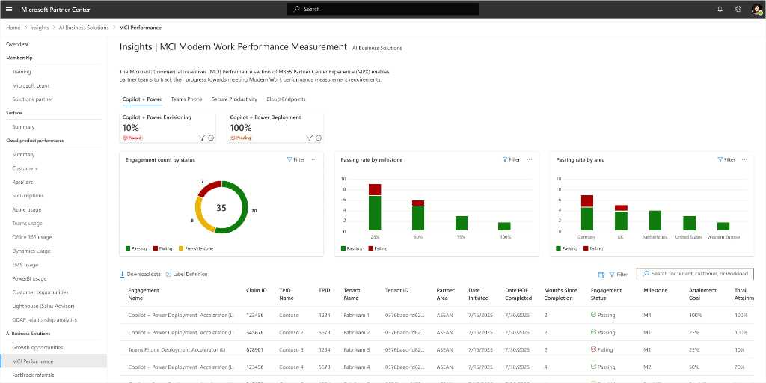

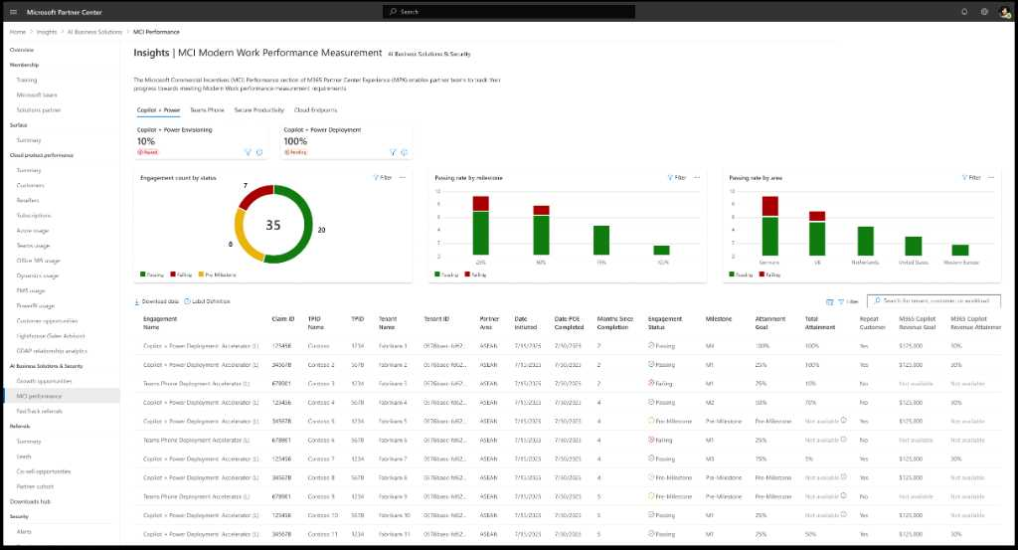
MCI MW Performance Measurement Overview
Track progress towards meeting Modern Work performance measurement requirements
The Microsoft Commercial Incentives (MCI) Performance Measurement report enables partner teams to track their progress towards meeting MCI eligibility.
Solution Plays
10%
80%
80%
Stage Level KPIs
Portfolio Level Charts
Engagement Level Table
Access Now at https://aka.ms/ASPXMCI
FY26 Copilot and Power Accelerate Partner Guide
41

Slide 42
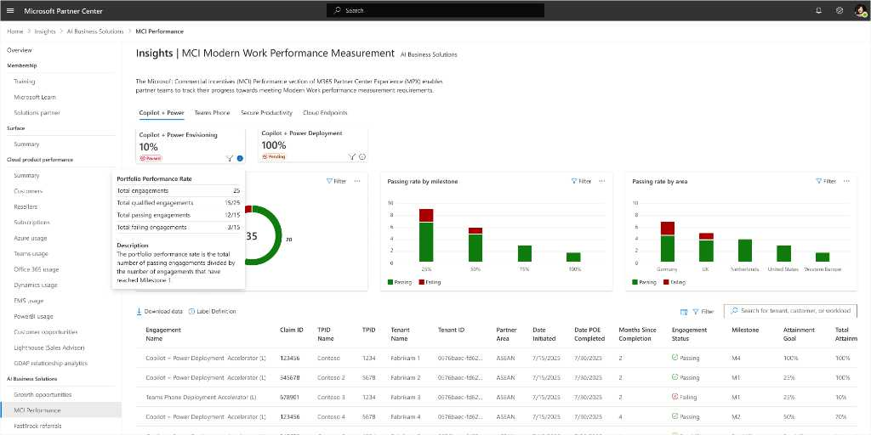
Portfolio KPIs
Portfolio Passing Rates and Program Status by Engagement Stage
The Microsoft Commercial Incentives (MCI) Performance Measurement report enables partner teams to track their progress towards meeting MCI eligibility.
80%
80%
Portfolio Passing Rate
Status
KPI Breakdown
Access Now at https://aka.ms/ASPXMCI
FY26 Copilot and Power Accelerate Partner Guide
42

Slide 43
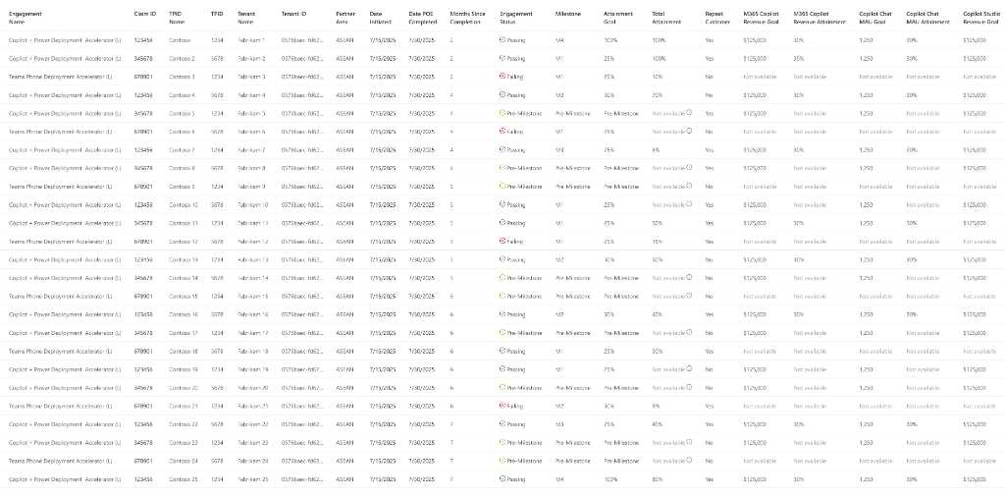



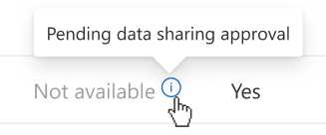
Engagement level Table
Engagement level Data
Basic Engagement Details
Engagement Status (Win Flag)
Total Attainment (>=100% is Passing)
Engagement Specific Metrics
4
M1
120%
60%
60%
$12,500
4
100%
60%
60%
$12,500
4
$12,500
4
M1
120%
$12,500
10/15/2025
10/30/2025
1
100%
$12,500
4
100%
$12,500
$12,500
10/15/2025
10/30/2025
1
$12,500
10/15/2025
10/30/2025
1
$12,500
4
$12,500
4
120%
$12,500
4
$12,500
4
M1
120%
$12,500
10/15/2025
10/30/2025
1
100%
$12,500
10/15/2025
10/30/2025
1
100%
$12,500
4
M1
120%
$12,500
10/15/2025
10/30/2025
1
100%
$12,500
4
120%
$12,500
4
100%
$12,500
10/15/2025
10/30/2025
1
100%
$12,500
4
M1
$12,500
4
M1
120%
$12,500
10/15/2025
10/30/2025
1
100%
$12,500
10/15/2025
10/30/2025
1
100%
$12,500
4
M1
120%
Access Now at https://aka.ms/ASPXMCI
FY26 Copilot and Power Accelerate Partner Guide
43

Slide 44
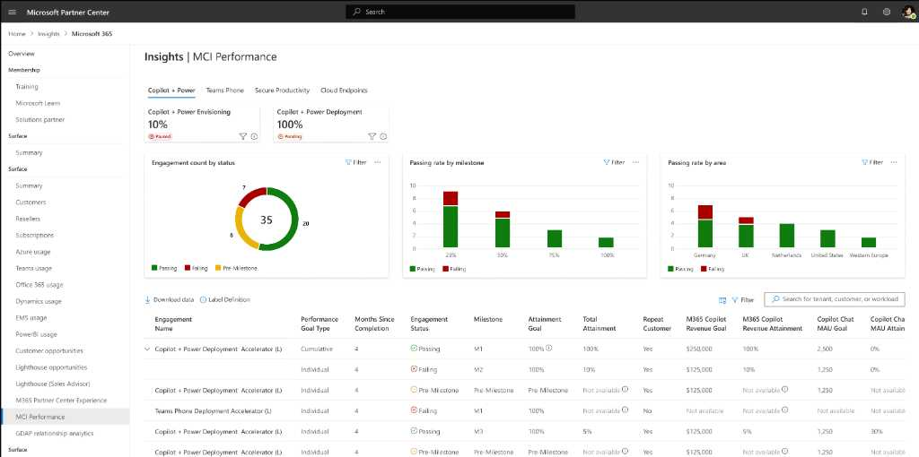
Repeat Engagements
Cumulative Goals – Coming Soon!
The Microsoft Commercial Incentives (MCI) Performance Measurement report enables partner teams to track their progress towards meeting MCI eligibility.
Nested View for Repeat Engagements
In Development
FY26 Copilot and Power Accelerate Partner Guide
44

Slide 45
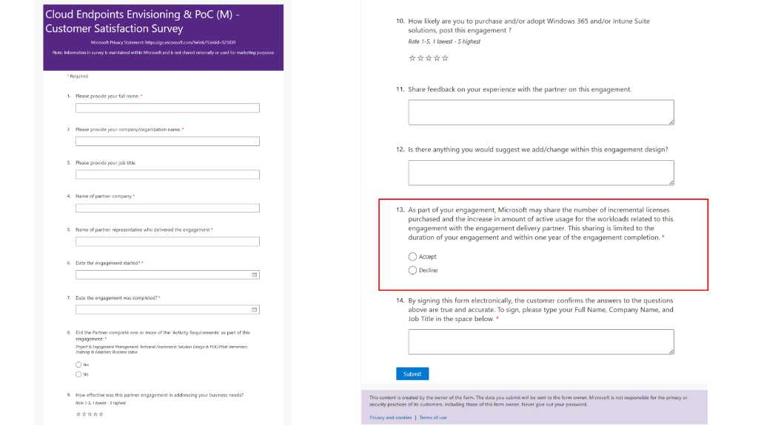
Customer attestation example in POE survey
FY26 Copilot and Power Accelerate Partner Guide
45

Slide 46
Partner Performance Measurement Resources
Performance Measurement policy and guidelines in the MCI Guide:
AKA.MS/incentivesguide
MCI MW Performance Measurement Dashboard in the AI Business Solutions & Security Partner eXperience: AKA.MS/ASPXMCI
Recording of MCI MW Performance Measurement Dashboard training:
aka.ms/ASPXMCIDashboardDemo
Modern Work Partner Performance Measurement Overview Deck: AKA.MS/MWPerformanceMeasurement/OverviewDeck
Modern Work Partner Performance Measurement Overview Recording: AKA.MS/MWPerformanceMeasurement/PartnerOverview

Slide 47
Partner maximum earning cap & concurrent engagement cap
Beyond performance accountability, these caps will apply to partners in FY26

Slide 48
Partner maximum earnings cap
Effective July 1, 2025, each Modern Work incentive initiative will have a maximum earning cap for all participating partners.
This cap will be applied to each participating partner at the PartnerOne level.
Partner earnings are defined as the amount of approved funding for completed and active engagements where Microsoft has received the customer’s approval.
Microsoft will evaluate extending the maximum earning cap for partners that reach their limit and are at or above their target portfolio performance rate based budget availability.
Maximum earning cap for Copilot + Power Accelerate
Incentive initiative | Earnings cap - Globals | Earnings cap – Regional SI
Copilot + Power Accelerate | $2,000,000 | $750,000

Slide 49
Copilot + Power Accelerate Concurrent engagement cap
The concurrent engagement cap implemented in FY25 will continue in FY26 for Copilot + Power Accelerate
Global services partners who operate globally in most of the Microsoft geographic areas are limited to a maximum of 200 active claims at any one time.
All other services partner organizations are limited to having a maximum of 65 active claims at any one-time.
Partners exceeding this limit may be paused from nominating new Copilot + Power Accelerate engagements.
This cap will be applied at the PartnerOne level.
This cap is likely to be retired by the end of H1 as performance accountability begins to take effect.

Slide 50
Proof of execution requirements
Proof of execution requirements and market definitions for engagement payout

Slide 51
Proof of execution requirements
To receive payment, please submit all three required components of proof of execution.
Customer Attestation (triggered by Partner,
completed by Customer)
Partner Survey (completed by Partner)
Invoice (uploaded by Partner) This refers to the partner invoice to Microsoft for completion of activity.

Slide 52
Account identification
Identify customer accounts with a high propensity to influence power metrics

Slide 53
Identify high propensity customers
Uncover opportunities across your existing Microsoft customer base by analyzing Copilot maturity.
Copilot Maturity
Use the Copilot Value Envisioning Tool to quantify opportunities by estimating:
Which customers have M365 Copilot licenses.
Where customers are in their AI transformation journey.
The white space for upsell, extensibility, and agent-based automation.
Maximize seat coverage with Copilot for All across all scenarios, including free entry points, paid licenses, and agent-led transformation.
Acquire
New customers
High propensity
Not penetrated with Copilot-paid licenses or Copilot Chat MAU
Monetize
Unpaid users
High propensity
Penetrated with Copilot Chat MAU but not Copilot-paid licenses
Grow
Existing customer
High propensity
20%+ Copilot-paid license penetration
Drive Copilot Chat MAU
Upsell free to paid license
Expand with agent-led value

Slide 54
Copilot Customer Propensity – Partner mapping logic
1
Data extract from LXP – Managed space
Data filter
Campaign List – Copilot Targeting list – M365 Target, Sales target, Service Target
Segments: Ent Commercial[Strategic + Majors], SMEC – Corporate, EDU, PS
2
Customer tranches & guidance
Acquire
Monetize
Grow
3
Partner selection
Copilot Jumpstart Partners Copilot - Ready & Prioritized Only
4
Customer list from LXP
Customer – Partner association logic
1. Map partners for each category/subcategory.
1. MSXI - Pipeline
Category 1: Pipeline – Partner associated in current pipeline for the TPID in area
Modern Work/Biz apps [Copilot Studio] pipeline – Copilot Solution play any sales stage
Modern Work/Biz apps pipeline – any sales stage with the largest $QP
Power platform pipeline – any sales stage with the largest $QP
Category 2: Intent creation – Partners who have engaged with customer specific to Copilot [FY24 ~ FY25]
FY25 Copilot Accelerate engagements: Approved and Completed
FY25 Low-code: Approved and Completed
FY26 Copilot + Power Accelerate engagements – Eligible, Approved, and Completed
Category 3: Usage impact – Partners who have delivered similar/associated services to customer [FY24 ~ FY25] OSU/CPOR
Copilot CPOR
Copilot Studio CPOR
Copilot CSP 1 & CSP 2 MAU
PAL – Partner admin link for power platform
Info protection
Category 4: Transaction – Partners who hold EA/CSP agreements with the customer [Current]
Transacting Partner of Record [TPOR]
2. Identify JS partner by highest rank.
2. MCI Engagements
3. If no JS partner, then designate as ‘white space’ → open for all ‘Prioritized’ partners only
Partner waterfall model for association
3. GPSinsights – OSU/CPOR
4. MS Sales
Partner-aligned customer propensity list

Slide 55
Partner CTA : Copilot
2
Tranche categorization and Partner CTA
Targeting Scenarios | Sub Tranche | Partner CTA
Acquire Acquire new customer, Drive penetration with Copilot Paid licenses or Copilot MAU | New to Copilot | Land Copilot Functional GTM conversations → Build Business case with BCB tool for M365 Copilot + Copilot Chat
 | Attach to EA Renewal | Leverage EA renewal compelling moment → Land Copilot Functional GTM conversations→ Build Business case with BCB tool H1 renewals: Engage immediately: H1 Renewal H2 renewals: Start engaging: H2 Renewal
Monetize Land Copilot for all leading with Copilot Chat targeting Information workers and Frontline workers | Usage Health → Getting Started | Engage with BDMs to identify high-impact scenarios and define roadmap. – Land Copilot Chat+Agents
 | Usage Health → Rapid Deployment | Engage to identify deployment and adoption with high-impact scenarios. – Land Copilot Chat+Agents
 | Usage Health → Not yet deployed | Engage to identify deployment and adoption with high-impact scenarios. – Land Copilot Chat+Agents
 | Usage Health → Deployed Low Usage | Identify blockers, high-impact scenarios and leverage Adoption resources. – Land Copilot Chat+Agents
Grow Drive extensibility with agents’ scenarios associated with high-impact business impact scenarios | Usage Health → Adopted | Lead with Copilot chat+agents for all – Sustain usage to drive expansion opportunity with Copilot extensibility

Slide 56
Jumpstart

Slide 57
Jumpstart | Copilot—tiered engagement model FY26
Access guidance, resources, and support as you build your Copilot practice and go-to-market journey
Unlock incentives based on performance
Attain the Copilot Specialization to further differentiate and develop your practice
GOALS
Eligibility criteria
Partner value
Prioritized
Customer wins + specialization attainment
Copilot Specialization++
Readiness: 10+ trained resources per area
Practice: validated practice including AI advisory, extensibility AND adoption + change management
Partners with proven impact
Key partners for co-sell
Established Copilot Practice
Copilot practice solution, services offer
5+ trained resources per area through learning channels and required courses
Meet required seats and MAU on internal usage of Copilot for Microsoft 365, agents and chat
Ready
Unlocked by partners with established practice/offer
Access to GTM investments
Community
Enlist for practice development
+1 Modern Work or Business Applications or Security Solutions Specialization
Invited eligible advisory/service partner
Max 6-month window to get to ‘Ready’ tier
Build with support
FY26 Copilot and Power Accelerate Partner Guide
57

Slide 58
Copilot Specialization

Slide 59
Introducing the new Copilot specialization
Prerequisite
Attain the Solutions Partner designation in Modern Work, Business Applications and/or Security
Differentiate partner capabilities in Copilot
Microsoft 365 Copilot, Copilot Chat, Copilot Studio and agents
Partners with this specialization should be able to help their customers with the following areas:
AI + Copilot advisory services
Assess readiness and deliver secure deployment plan
Copilot adoption + change management
Extensibility with agentic focus
Performance requirements
1,000 MAU growth of Microsoft 365 Copilot in TTM (CPOR, CSP Tier 1, 2)
5 M365 Copilot net customer growth in TTM (CPOR, CSP Tier 1, 2)
Skilling requirements
5 people with MS-102 M365 Certified: Enterprise Administrator Expert
AND
5 people with cumulatively:
SC-401: Implement Information Protection in Microsoft 365
OR
APL-4002: Prepare security and compliance to support Copilot
AND
5 people with APL-7008: Create agents in Microsoft Copilot Studio
Customer references
Provide three customer references which must include at least one example of transforming business process with agent implementation
FY26 Copilot and Power Accelerate Partner Guide
59

Slide 60



FY26 Modern Work – Incentive Details
Market A, B, and C Countries
Incentive Rate Card
Engagement claim amounts will be calculated in USD, based on the country associated with the Partner Location ID listed in the claim, or until program cap is reached.
Market A countries are Australia, Austria, Belgium, Canada, Denmark, Finland, France, Germany, Iceland, Ireland, Italy, Japan, Luxembourg, Netherlands, New Zealand, Norway, Portugal, Spain, Sweden, Switzerland, United Kingdom, and United States.
Market B countries are Bahrain, Barbados, Brazil, Cayman Islands, Chile, China, Colombia, Cyprus, Czechia, Estonia, Greece, Hong Kong, Indonesia, Israel, Jamaica, Korea, Kuwait, Latvia, Lithuania, Malaysia, Malta, Mexico, N. Macedonia, Oman, Philippines, Poland, Puerto Rico, Qatar, Saudi Arabia, Senegal, Singapore, Slovakia, Slovenia, South Africa, Taiwan, Thailand, U.A.E. and Uruguay.
Market C will include all other countries/regions eligible for Microsoft Commerce Incentives.
Claim Type | Engagement Name | Market A | Market B | Market C
Partner-initiated | Cloud Endpoints Envisioning & PoC (S) | $10,000 | $7,500 | $5,000
Partner-initiated | Cloud Endpoints Envisioning & PoC (M) | $20,000 | $15,000 | $10,000
Partner-initiated | Copilot + Power Deployment Accelerator (XS) | $5,000 | $3,750 | $2,500
Partner-initiated | Copilot + Power Deployment Accelerator (S) | $10,000 | $7,500 | $5,000
Partner-initiated | Copilot + Power Deployment Accelerator (M) | $25,000 | $18,750 | $12,500
Partner-initiated | Copilot + Power Deployment Accelerator (L) | $50,000 | $37,500 | $25,000
Partner-initiated | Copilot + Power Envisioning & PoC (XS) | $5,000 | $3,750 | $2,500
Partner-initiated | Copilot + Power Envisioning & PoC (S) | $10,000 | $7,500 | $5,000
Partner-initiated | Copilot + Power Envisioning & PoC (M) | $25,000 | $18,750 | $12,500
Partner-initiated | CSP Deployment Accelerator for ME3/ME5 (S) | $8,000 | $6,000 | $4,000
Partner-initiated | CSP Deployment Accelerator for ME3/ME5 (M) | $13,000 | $10,000 | $6,000
Partner-initiated | CSP Deployment Accelerator for ME3/ME5 (L) | $25,000 | $20,000 | $12,000
Partner-initiated | CSP Deployment Accelerator for ME3/ME5 (XL) | $38,000 | $30,000 | $18,000
Partner-initiated | Secure Productivity Envisioning & PoC (S) | $7,500 | $5,625 | $3,750
Partner-initiated | Secure Productivity Envisioning & PoC (M) | $15,000 | $11,250 | $7,500
Microsoft-initiated | Secure Productivity Envisioning & PoC (L) | $30,000 | $22,500 | $15,000
* Tax & Withholding: Incentive payments for MCI Partner Activities include payment amount as specified in
the claim details and do not include additional VAT or GST except in China, Korea and India
FY26 Copilot and Power Accelerate Partner Guide
60

Slide 61
Customer-Partner Geographic Claiming Policy
Partners may only claim customers if the claiming Partner's location matches the same Market Rate as the customer's headquarters area. Partners can find the Market Rate mapping in the Modern Work Incentive Details slide.
Claims from higher rate Market Rate locations or outside of the customer's headquarters area may result in being paused from Microsoft Commercial Incentives.
Examples
Examples of Compliant Claims:
• Claiming Partner Location ID is Market A, and the customer's tenant area is in Market A • Claiming Partner Location ID is Market B, and the customer's tenant area is in Market B • Claiming Partner Location ID is Market C, and the customer's tenant area is in Market C • Claiming Partner's country is within the customer's tenant area
Examples of Non-Compliant Claims:
Claiming Partner Location ID is Market A, and the customer's headquarters area is in Market B or C
For example, a Partner located in Australia (Market A) cannot claim a customer located in Vietnam (Market C)
Claiming Partner's country is outside the customer's tenant area
Partners claiming customers outside of their tenant area may be paused or removed from Microsoft Commercial Incentives
FY26 Copilot and Power Accelerate Partner Guide
Refer to the MCI Guide for more information.

